Slide 1
CUSTOMER BEHAVIOR ANALYSIS AND QUOTATION SUCCESS PREDICTION USING MACHINE LEARNING FOR SALES OPTIMIZATION
University of Sri Jayewardenepura
Supervisor : Dr. Ravimal Bandara
Research by : D.D.S.D. Chandrasiri
Index : MSC/DSA/093

Slide 2
Significance of the research
Sales teams struggle to predict which quotations will succeed.
Helps focus on high-success leads, saving time and effort.
Supports data-driven sales strategies using machine learning.

Slide 3
Objectives & Scope
Objectives :
Analyze customer behavior patterns influencing quotation outcomes.
Develop a machine learning model to predict quotation success.
Research Questions :
What Customers & Quotation features influence success rates ?
How accurately can machine learning models predict Quotation outcomes ?
Scope :
Focused on Quotation and Customer data from a private Electrical Company.
Includes Customer profiles, sales metrics, item details, and quotation status.
Applies Supervised Machine Learning Models (eg : Logistic Regression, Random Forest)
Limitations :
Dataset limited to one company and industry sector.
Quality of predictions depends on data completeness and accuracy.

Slide 4
Literature review
Key Works
ML used in customer segmentation, quotation prediction, and sales forecasting.
Models: Logistic Regression, Decision Trees, Random Forests.
Trends
Use of ML for sales optimization and predictive analytics.
Focus on feature engineering and model accuracy.
Gaps
Few studies integrate customer behavior with quotation data.
Lack of interpretable models for B2B electrical sectors.

Slide 5
Literature review
Study | Focus Area | Method Used | Gap Identified
Ahmed & Zhao (2021) | B2B quotation analysis in manufacturing | Decision Trees | Focused only on price sensitivity, not behavior
Liu et al. (2022) | ML for Customer churn in retail | Random Forest | Retail-focused, not applicable to B2B sales
Mehta & Roy (2023) | Success prediction of sales quotations | Logistic Regression | Limited feature engineering, no behavioral analysis

Slide 6
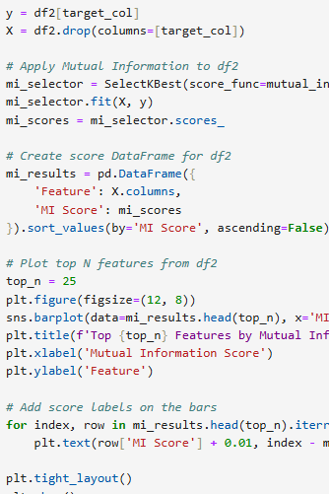
Methodology

Slide 7
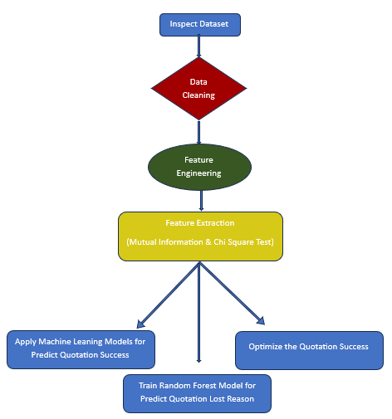

Slide 8
Methodology
Feature Engineering Features : Date Based Features (Quotation Duration), Customer Behavior Features (Customer Loyalty Score), Financial Ratios (Discount Percentage, Margin Percentage, Cost to Value Ratio), Item Features (Item Success Rate)
2. Feature Extraction :
Mutual Information Method – Base Grand Total, Quotation Duration, Account Manager $ Sales Manager, Cost to Value Ratio, Total Quantity, Margin, Margin Percentage, Discount Percentage.
Chi Square Test – Base Grand Total, Base Total Taxes & Charges, Total Cost, Base Net Amount
Machine Learning Models - Logistic Regression, Decision Tree Classifier, Random Fores Classifier, Support Vector Machine.
4. Optimize Quotation Success – Use bar chart for identify high frequency reasons effect to lost quotations & Based on the identified reasons optimize the Quotation Lost.

Slide 9
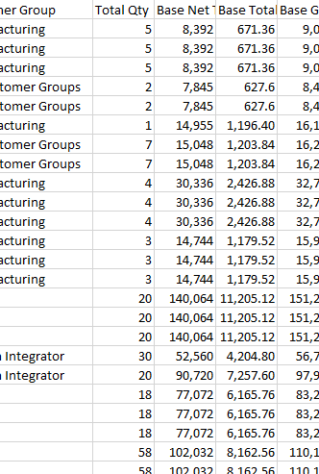



Data & Tools
Data Source
Collected from Private Electrical Company.
Includes quotation records, customer details, item costs, margins, success/failure status, and more.
Time span: Aug 2022 – Mar 2025
Data Characteristics
Total Records – 216,295
Features: Customer info, quotation status, financial metrics, product data.
Target Variable – Status
Tools & Technologies
Python for Data Processing, feature engineering & model building.
Jupiter Notebook as the development environment.
Libraries used – Pandas, NumPy, Scikit- learn, Matplotlib, Seaborn, Statsmodels

Slide 10
Results
Machine Learning Models for Predict Quotation Success
Random Forest Classifier demonstrated superior prediction performance
Random Forest Classifier achieved 88.02% accuracy in predicting lost reasons.
Identify Quotation Lost Reason : Out of Stock – The items
Price - The Customers
Other Brand - The Items
Lead Time - The Account Managers
Machine Learning Model | RMSE Value | Accuracy
Logistic Regression | 1.1671 | 0.6016
Decision Tree Classifier | 0.7643 | 0.8741
Random Forest Classifier | 0.7044 | 0.8938
Support Vector Machine | 1.1634 | 0.6726

Slide 11

Discussion
Model Performance:
Random Forest Classifier demonstrated superior prediction performance
Random Forest classifier predicted lost reasons with 88.02% accuracy.
Key Findings:
Identified lost reason patterns from quotation data.
Enables targeted strategies to reduce loss rates and improve quotation success.
Prior studies rarely used real-world quotation data.
This work fills the gap with quotation-level B2B prediction in the electrical sector.

Slide 12
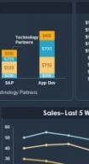
Limitations
Data Source Limitation: Data was collected from a single private electrical company, which may limit generalizability across industries.
Feature Availability: Not all potential behavioral or contextual variables (e.g., competitor pricing, customer feedback) were available.
Model Bias Risk: Machine learning models may be influenced by historical biases in the data.
Limited Ground Truth for Lost Reasons: Some quotations marked as "lost" may lack detailed or accurate loss reasons.
Time Constraints: The dataset may not cover long-term customer behavior changes.
Tool Dependency: Analysis was limited to tools available in Jupiter Notebook and Python.

Slide 13
Conclusion & future work
Contributions:
Developed a tailored ML pipeline using real company sales data.
Engineered key features from customer, financial, and item data.
Provided insights to support data-driven sales strategies.
Future Work:
Deploy models in real-time sales environments.
Integrate external market data and time-based analysis.
Create interactive tools for sales teams.
Explore causal analysis for deeper business understanding.

Slide 14
Practical implications
Relevance:
Empowers data-driven decision-making in sales.
Reveals key factors affecting quotation success.
Supports customer-focused and efficient sales strategies.
Applications:
Predictive scoring of quotations for prioritization.
Optimized pricing and discount strategies.
Improved stock planning based on forecasted success.
Sales team performance insights.
Targeted customer retention initiatives.

Slide 15
references
Tran & Dung (2017) – ML for customer behavior prediction (case study in Vietnam)
Wang (2023) – Digital marketing strategy optimization in China
Webster & Wind (1972) – Foundational model for organizational buying behavior
Anderson & Narus (1990) – Manufacturer-distributor partnership framework
Johnston & Lewin (1996) – Integrative model of organizational buying behavior
Jagdish et al. (2012) – Review of relationship marketing concepts and evolution

Slide 16
Thank you
D.D.S.D. Chandrasiri
MSC/DSA/093

